Slide 1
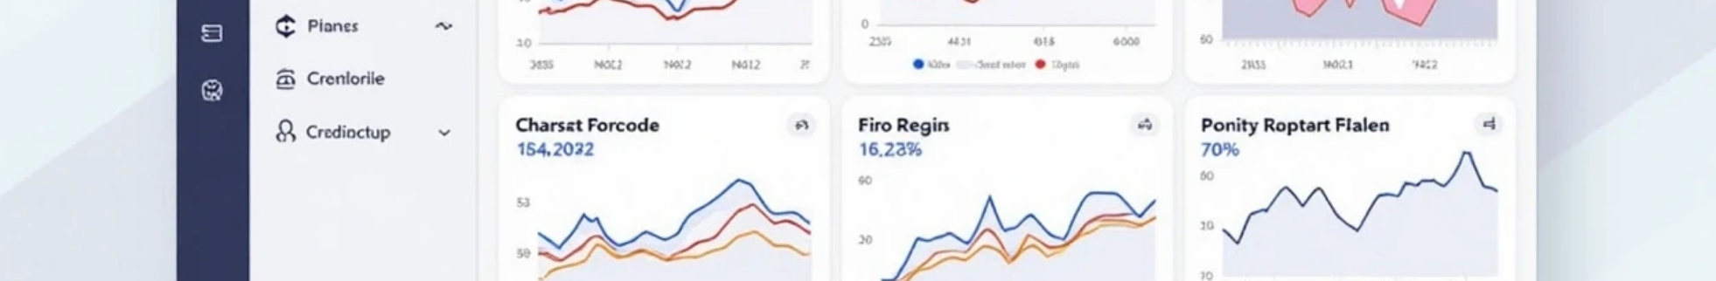

Sales Forecasting Dashboard: Streamlit & Machine Learning

Slide 2

CONTENTS
1. Introduction
2. Key Features
3. Tech Stack
4. Installation
5. Usage
6. Example Input CSV
7. Example Output
8. Project Structure
9. Future Enhancements
10. Author

Slide 3

1. Introduction
This project is an interactive sales forecasting web application built using Python, XGBoost, and Streamlit. It predicts future sales trends based on historical data and provides clear, dynamic visualizations. Users can upload their own sales CSV files, retrain the model directly in the browser with adjustable hyperparameters, and visualize predictions with confidence intervals. The project is designed to help businesses make data-driven decisions by forecasting future sales performance efficiently.

Slide 4







2. Key Features
Interactive Streamlit Dashboard
Machine Learning Model (XGBoost)
view, analyze, and forecast sales data in real-time.
trained on historical time series sales data.
Confidence Intervals (95%)
Model Retraining
visualize prediction uncertainty with shaded intervals.
upload your own CSV file and retrain the model with custom hyperparameters.
Download Forecasts
Backtest RMSE Display
export predictions as a CSV file.
evaluate model accuracy on recent data.
Clean Visualization
built with Matplotlib for a professional presentation.

Slide 5








3. Tech Stack
1
2
3
Python 3.10+
Streamlit: UI framework for interactive dashboards
XGBoost: gradient boosting algorithm for time series forecasting
4
5
6
Scikit-learn: metrics and preprocessing
Matplotlib: data visualization
Pandas & NumPy: data handling and feature engineering

Slide 6

4. Installation
Clone the repository:
git clone https://github.com//sales-forecast-dashboard.git cd sales-forecast-dashboard
Install dependencies:
pip install -r requirements.txt
Run the Streamlit app:
streamlit run app.py
Then open your browser and go to 👉 http://localhost:8501

Slide 7

5. Usage
Upload your historical sales data (date, sales) in CSV format. Choose forecast horizon (1–12 months) using the sidebar slider. Optionally, retrain the model using custom hyperparameters. View forecast plots with confidence intervals. Download your forecast results as a CSV file.

Slide 8

6. Example Input CSV
date,sales 2020-01-01,1540 2020-02-01,1600 2020-03-01,1625 2020-04-01,1580 2020-05-01,1655 ...

Slide 9










7. Example Output
1
2
Line chart showing historical vs predicted sales
Forecast for the next N months
3
4
RMSE metric for model accuracy
Downloadable CSV with predictions

Slide 10

8. Project Structure
sales-forecasting/ ├── app.py /# Streamlit web dashboard ├── monthly_sales_forecast.py /# Model training and forecasting script ├── load_and_eda.py /# Data loading and EDA ├── processed_sales.csv /# Feature-engineered dataset ├── sales_forecast_model.pkl /# Trained XGBoost model ├── synthetic_monthly_sales.csv /# Example dataset └── requirements.txt /# Dependencies

Slide 11






9. Future Enhancements
1
Deploy to Streamlit Cloud / HuggingFace Spaces
2
Auto hyperparameter tuning
3
Email/Report generation for forecasts
4
Integration with Google Sheets or SQL database

Slide 12

10. Author
Developed by [jaya sree]
If you like this project, please ⭐ the repository and share your feedback!

Slide 13

Thank You

